Slide 1
















INT104 – Database Management System Unit – II

Slide 2


Need For Database Design
Design Guidelines for Relational Databases
Problems

Slide 3
Recap
Various aspects of the
Relational Model
Languages associated with it.
Each relation schema
consists of a number of attributes,
Relational database schema
consists of a number of relation schemas
Assumption
Attributes are grouped to form a relation schema by using the common sense of the database designer
By mapping a database schema design from a conceptual data model such as the ER or enhanced-ER (EER) data model.

Slide 4
Introduction
Need
Guidelines to measure the quality of the design
other than the intuition of the designer
Theory - Evaluate the relational schemas for design quality
Why one set of groupings of attributes into relation schemas is better than another?

Slide 5
Introduction
There are two levels at which we can deliberate the goodness of relation schemas.
First is the logical (or conceptual) level
How users interpret the relation schemas and the meaning of their attributes?
Having good relation schemas at this level enables users to understand clearly the meaning of the data in the relations
Hence to formulate their queries correctly.
Second is the implementation (or physical storage) level
How the tuples in a base relation are stored and updated?

Slide 6
Approaches to Database Design
Database design may be performed using two approaches:
Bottom-up design methodology (design by synthesis)
Considers individual attributes as the starting point and uses those to construct relation schemas.
Top-down design methodology (design by analysis)
Starts with a number of groupings of attributes relations that exist together naturally
For example, on an invoice, a form, or a report.
into
The relations are then analyzed individually and
all
collectively, leading to further decomposition until
desirable properties are met.

Slide 7
Goal
Relational database design ultimately produces a set of relations.
The implicit goals of the design activity are
Information preservation
Minimum redundancy.

Slide 8
Design Guidelines for Relational Databases
Four informal guidelines that may be used as measures to determine the quality of relation schema design:
Making sure that the semantics of the attributes is clear in the schema
Reducing the redundant information in tuples
Reducing the NULL values in tuples
Disallowing the possibility of generating spurious tuples

Slide 9
1. Semantics of the Relational Attributes must be clear
GUIDELINE 1:
Each tuple in a relation should represent one entity or relationship instance. (Applies to individual relations and their attributes).
Attributes of different entities (EMPLOYEEs, DEPARTMENTs, PROJECTs) should not be mixed in the same relation
Only foreign keys should be used to refer to other entities
Entity and relationship attributes should be kept apart as much as possible.

Slide 10
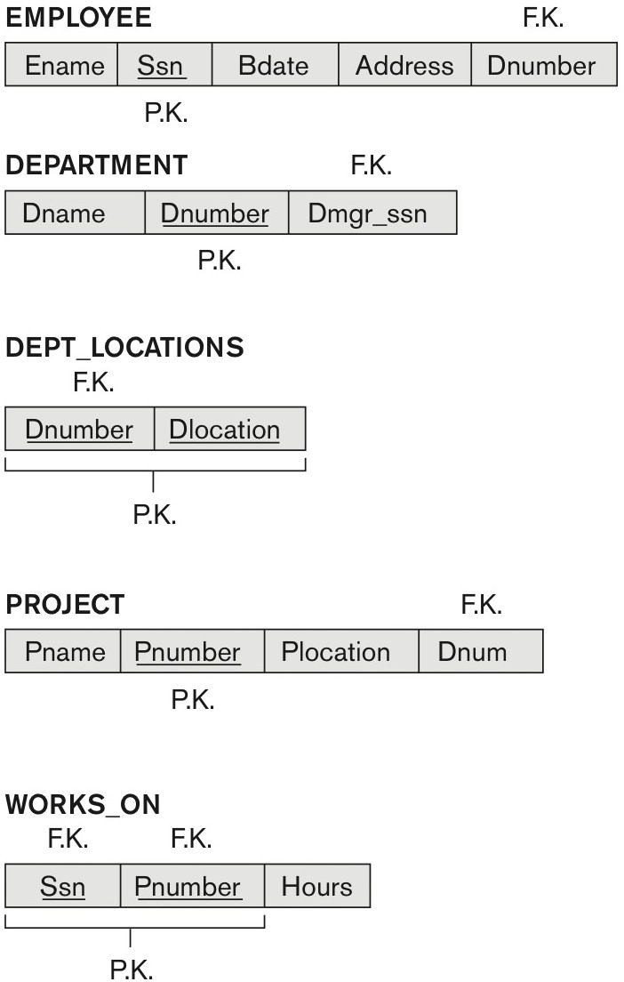
A simplified COMPANY relational database schema

Slide 11
Redundant Information in Tuples and Update Anomalies
Information is stored redundantly
Wastes storage
Causes problems with update anomalies
Insertion anomalies
Deletion anomalies
Modification anomalies
➢

Slide 12
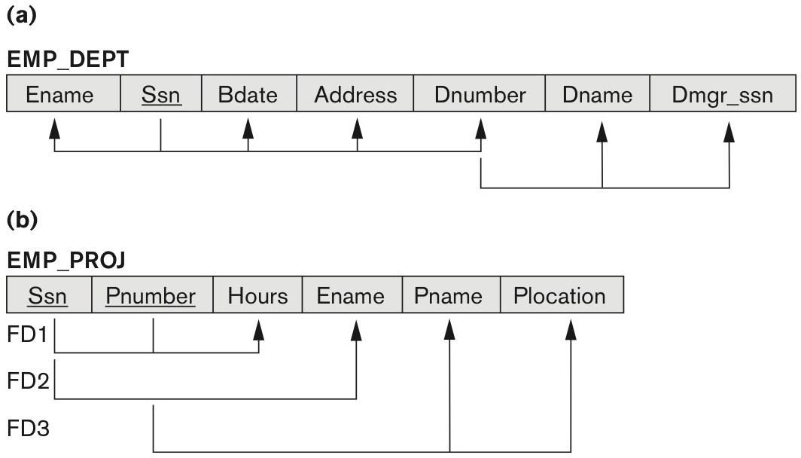
Redundant Information in Tuples and Update Anomalies

Slide 13
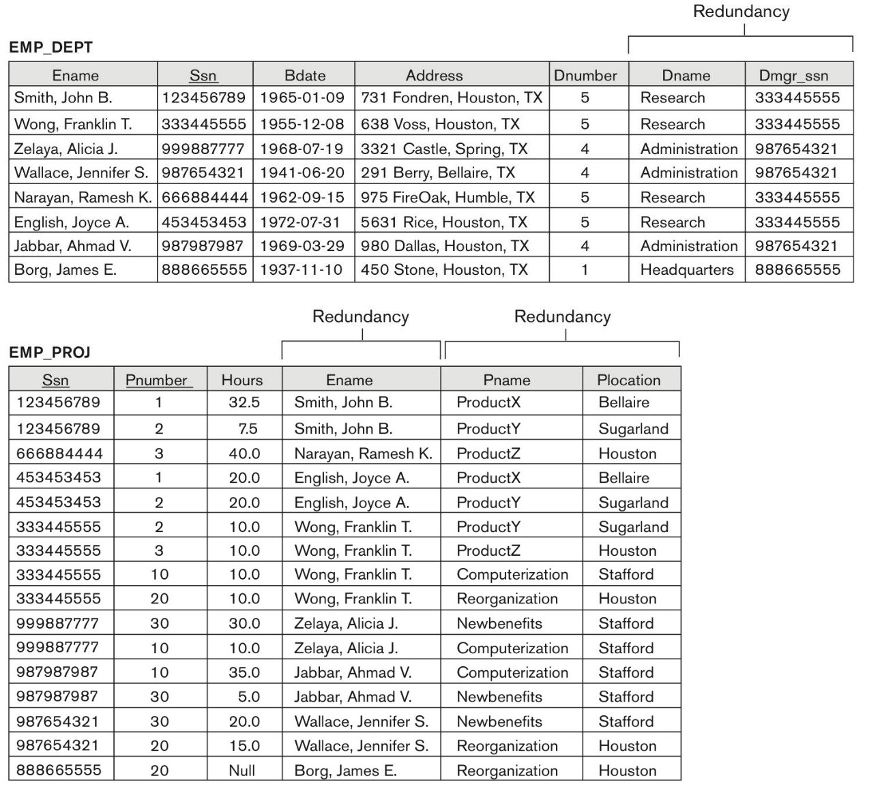
Redundant Information in Tuples and Update Anomalies

Slide 14
EXAMPLE OF AN UPDATE ANOMALY
Consider the relation:
EMP_PROJ(Emp#, Proj#, Ename, Pname, No_hours)
Update Anomaly:
Changing the name of project number P1 from “Billing” to “Customer-Accounting” may cause this update to be made for all 100 employees working on project P1.

Slide 15
EXAMPLE OF AN INSERT ANOMALY
Consider the relation:
EMP_PROJ(Emp#, Proj#, Ename, Pname, No_hours)
Insert Anomaly:
Cannot insert a project unless an employee is assigned to it.
Conversely
Cannot insert an employee unless an he/she is assigned to a project.

Slide 16
EXAMPLE OF A DELETE ANOMALY
Consider the relation:
EMP_PROJ(Emp#, Proj#, Ename, Pname, No_hours)
Delete Anomaly:
When a project is deleted
it will result in deleting all the employees who work on that project.
Alternately
if an employee is the sole employee on a project, deleting that employee would result in deleting the corresponding project.

Slide 17
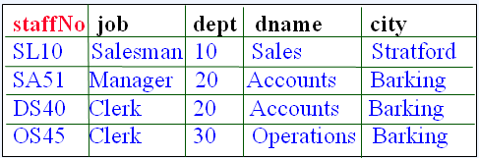
Another Example
Example: We have the following relation that contains staff and department details:
Such ‘redundancy’ could lead to the following ‘anomalies’
Insert Anomaly: We can’t insert a dept without inserting a member of staff that works in that department
Update Anomaly: We could change the name of the dept that SA51 works in without simultaneously changing the dept that DS40 works in.
Deletion Anomaly: By removing employee SL10 we have removed all information pertaining to the Sales dept.

Slide 18
Guideline for Redundant Information
in Tuples and Update Anomalies
GUIDELINE 2:
Design a schema that does not suffer from the insertion, deletion and update anomalies.
If there are any anomalies present, then note them so that applications can be made to take them into account.

Slide 19
NULL Values in Tuples
GUIDELINE 3:
Relations should be designed such that their tuples will have as few NULL values as possible
Attributes that are NULL frequently could be placed in separate relations (with the primary key)
The difficulty of performing selections, aggregation operations, and joins.
Reasons for nulls:
Attribute not applicable or invalid
Attribute value unknown (may exist)
Value known to exist, but unavailable

Slide 20
Generation of Spurious Tuples
GUIDELINE 4:
The relations should be designed to satisfy the lossless join condition.
No spurious tuples should be generated by doing a natural-join of any relations.
Bad designs for a relational database may result in erroneous results for certain JOIN operations
The "lossless join" property is used to guarantee meaningful results for join operations

Slide 21
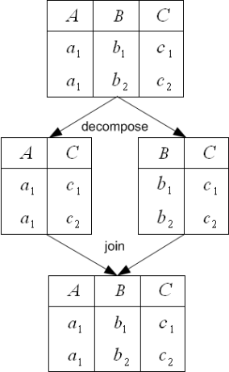
Join without Spurious Tuples

Slide 22
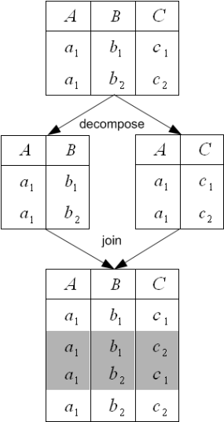
Join with Spurious Tuples

Slide 23
Summary of Design Guidelines
The problems listed
which can be detected without additional tools of analysis, are as follows:
Anomalies that cause redundant work to be done during insertion , deletion and Updation
Waste of storage space due to NULLs
Generation of invalid and spurious data during joins on base relations

Slide 24


